Slide 1
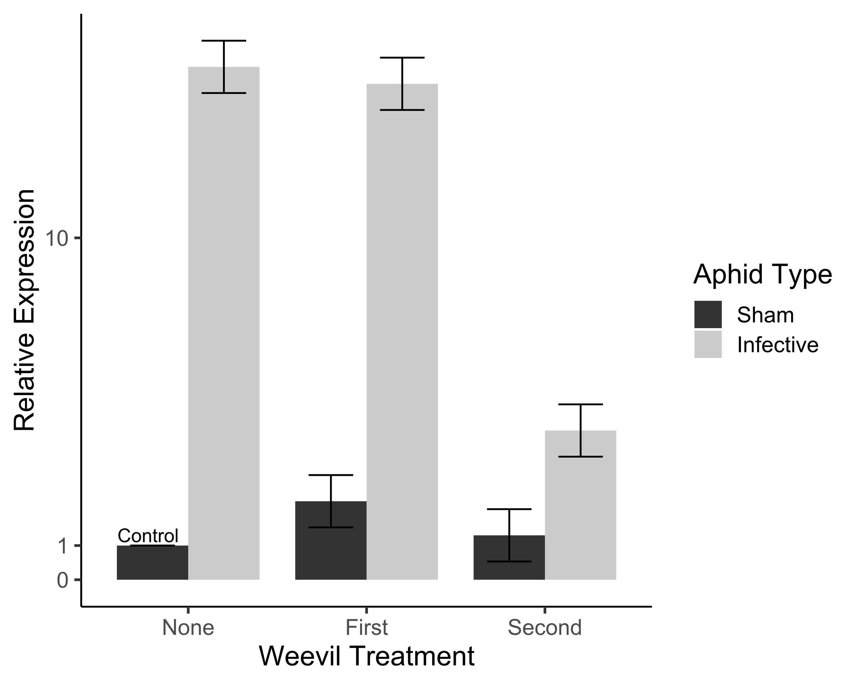
Nov 20 iteration

Slide 2
Nov 18 iteration

Slide 3
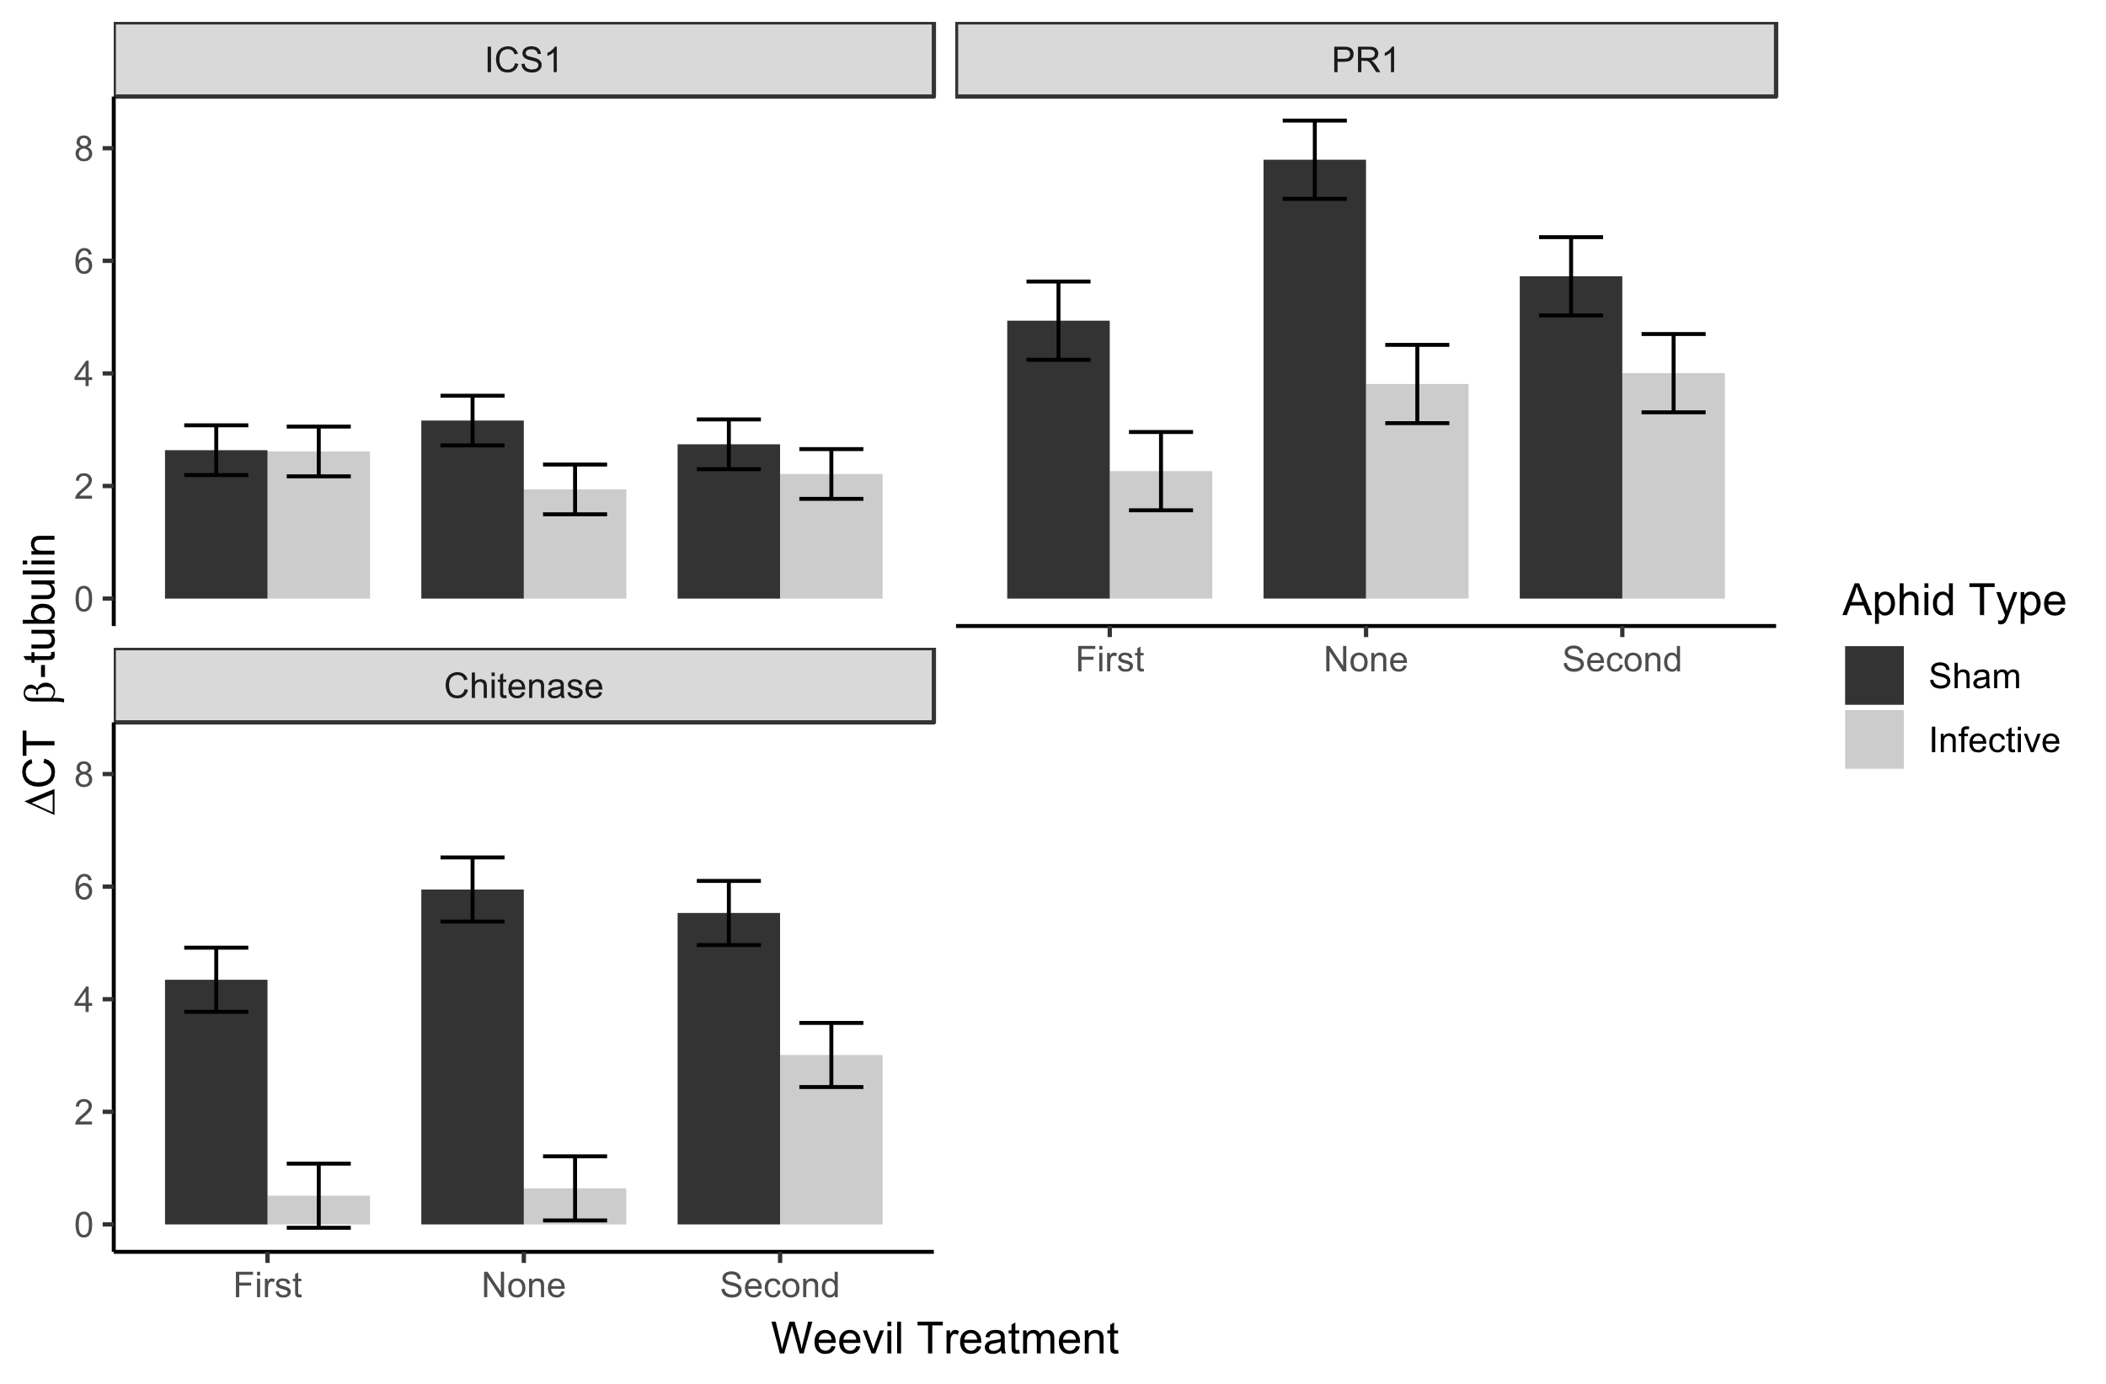
Nov 10 iteration

